Slide 1
Economic Trading Platform– Group Project
Deekshit Garakahalli Vidya Sagar, Nosente Goll & Ben Lynch

Slide 2
AGENDA
Introduction
Purpose
Planning
Application’s Architecture
Demo
Road Blocks
In the Future…
Conclusion
Q & A

Slide 3
INTRODUCTION
Welcome to our presentation of our Full Stack Java Application for an Electronic Trading System.

Slide 4
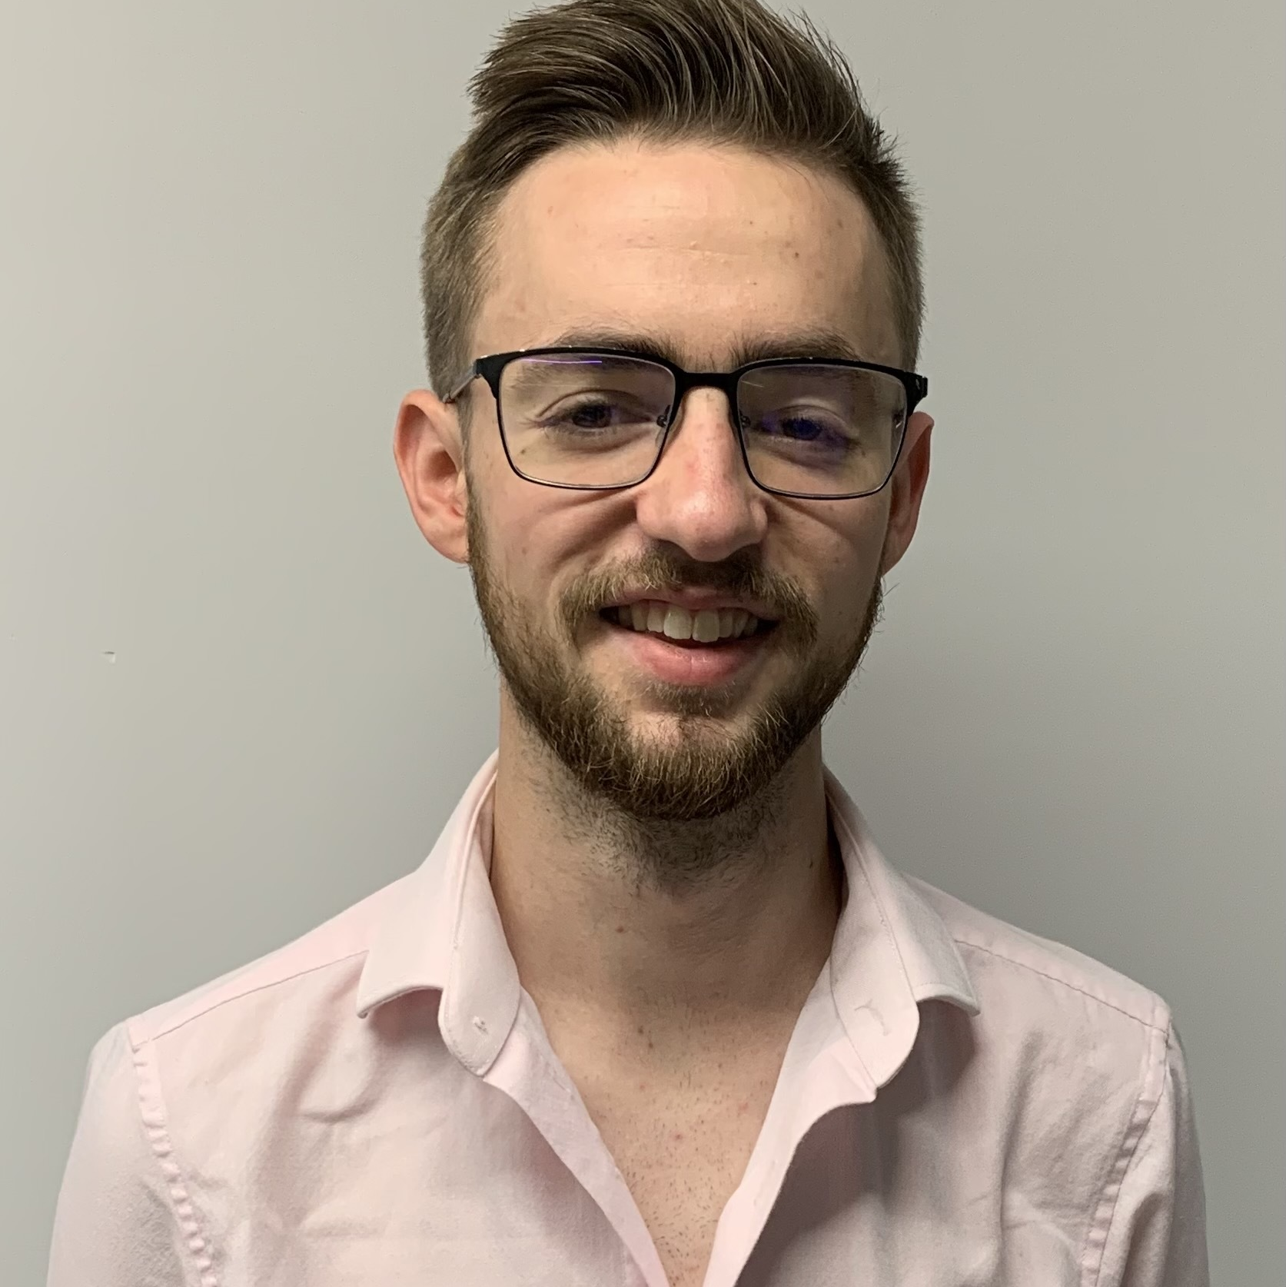

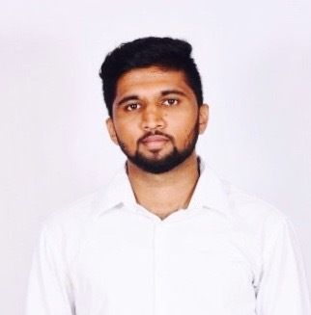
MEET OUR TEAM
Ben Lynch
Nosente Goll
Deekshit Garakahalli Vidya Sagar
Product Owner
Full Stack Development
Database Developer
UX/UI
Back End Development
Tester
Scrum Master
Database Developer
Back End Development
Tester
Database Developer

Slide 5
Purpose
Electronic Trading System
Notes:
Deekshit:
The purpose of our project was to develop a full stack java application for an electronic trading platform.
The application should allow clients to place buy and sell orders for trading, to be able to view their order status and trade history.
Ben:
Although, these are simple operations they required a fully developed database, back and front end development. We also wanted to make the platform as user-friendly
as possible. *And ensuring the website’s aesthetics were pleasing.
Nosente:
As a group, we understood that this would be a big task and made it our priority to plan in detail all parts of the project that we would like to do, the requirements for the project and who we believed would be best suited for different tasks.

Slide 6
Life cycle
Scrum Meetings
Roles: - Database Developing - Back end (Nosente & Deekshit) - Front (Ben)
User Stories
MVP
Minimal Viable Product
Sprint Lengths
Sprint lengths usually 2 days but open to adjust.
Road Blocks
Limitations & Extenuating circumstances

Slide 7
PLANNING – DAY TO DAY
Morning
Scrum meeting
Updates
Drive & Navigator Coding
Presenting research
Afternoon
Scrum meeting part 2
Testing
Sprint coding
Reviewing work & future

Slide 8
Application’s architecture
Tier 3 – Front End
Tier 1 – Back End
Tier 2 - Database
Electronic Trading Website
JavaScript
Gatsby
React
CSS / JSX
​​​Business Logic, Controllers, Repositories
Java
Spring
Junit Testing
Lombok
JPA
Stock Exchange – Database
MySQL
PHP admin

Slide 9
Application’s architecture example - register / LOGIN
Tier 3 – Front
Tier 1 – Back
Tier 2 – Database
REQUEST
REQUEST
RESPONSE
RESPONSE

Slide 10
Application’s architecture example - ALL OTHER METHODS
Tier 3 – Front
Tier 1 – Back
Tier 2 – Database
User Entity
REQUEST
REQUEST
AUTHORISE
RESPONSE
REQUEST
RESPONSE

Slide 11
dEMO

Slide 12
Road Blocks
Spring Security
SORT Algorithm
Lombok
Testing
State Persistence
Implementation
Making state available across multiple components
Implementing multiple orders
Testing was dependent on other tiers and implementations
Implementation

Slide 13
Future plans
FRONT END
BACK END
Design
Application Evolution
Scalability
SORT & EXCHANGE
Security
Order Book
Notes:
Front end
- Responsive and adaptive design
- Application Evolution
- Visual representations of trades
Backend
Scalability
Expanding the implementation of a sort algorithm and exchange.
Ensuring spring security works efficiently and maintains multiple sessions
Expanding order book functionality
Ability to view trade history (although it is stored)

Slide 14
SUMMARY
This has been a very enlightening process for all of us in terms of developing software in for all elements of full stack.
Thank you to Kishore for your help and to our colleagues for the help also!

Slide 15
THANK YOU

